Slide 1


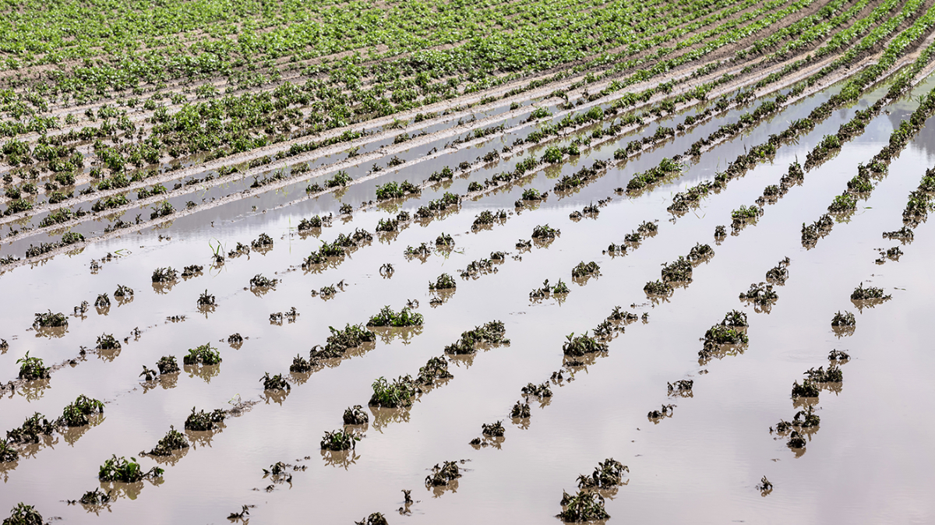
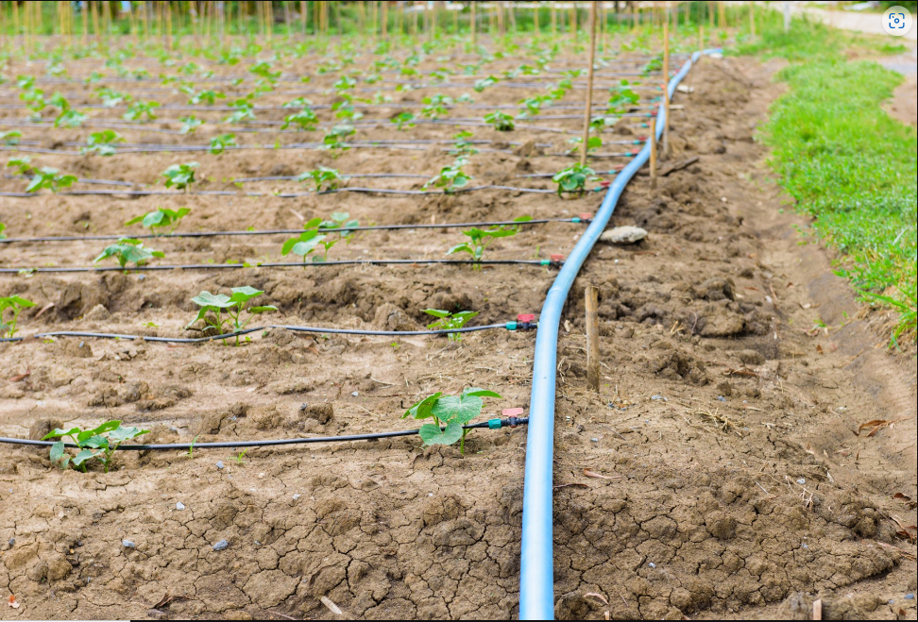
Instrumentation Project Presentation
Project Title:- Smart Drip Irrigation-Supply and Discharge
Members:- 1) Tejas Varade (200003082)
2) Ajeet Kumar (200003006)
3) Amit Dhavale(200003011)
4) Jyotirmay Mitra(200003038)

Slide 2
Problem Statement
To analyze moisture content and water-logging conditions in soil and automatically open the valves of main drip line accordingly.

Slide 3
Motivation
Difficulties faced today:-
Traditional drip irrigation involves the farmers’ active participation and so it increases labour.
As far as smart irrigation systems available in market are concerned, they are mostly applicable to extensive farming.
So to reduce the labour and prevent water wastage at relatively lower price our setup comes into the picture.
Our solution:-
Arduino based smart, low-cost water level maintaining device, which takes input from the user for required level.
To discharge excess water in case of water logging conditions.

Slide 4
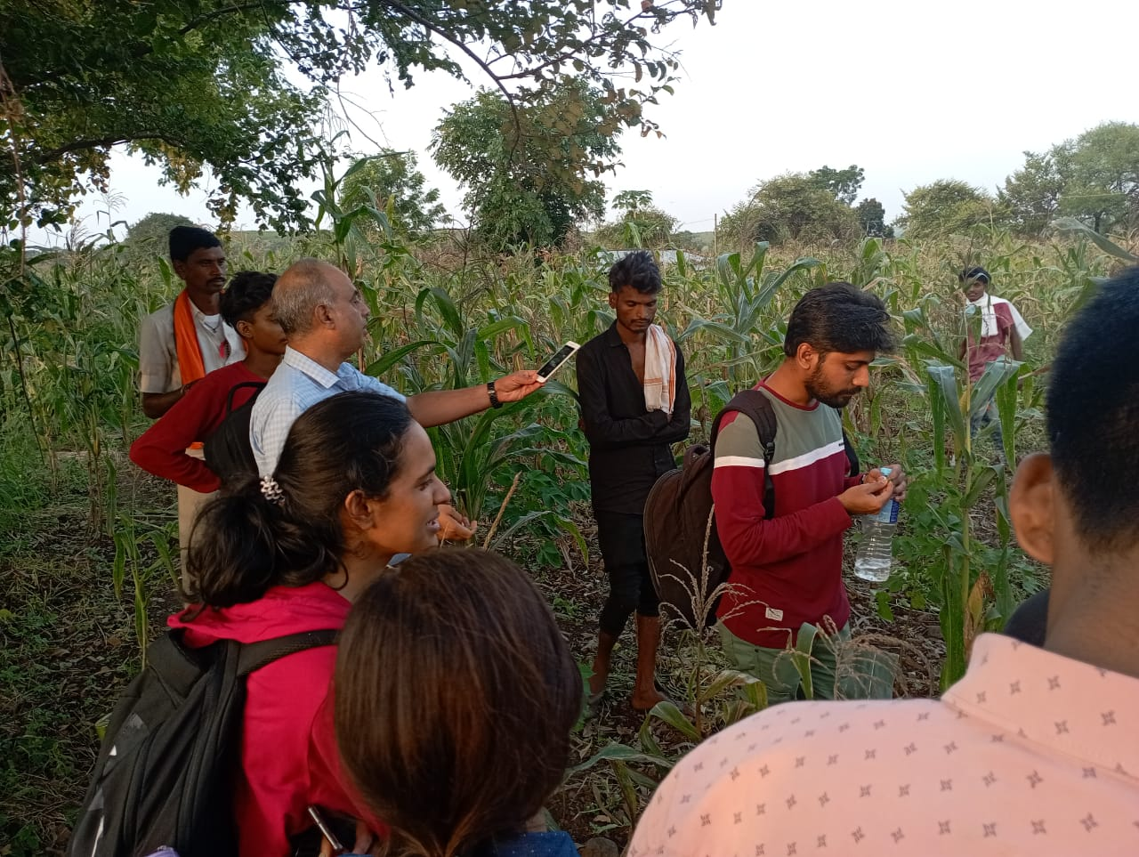
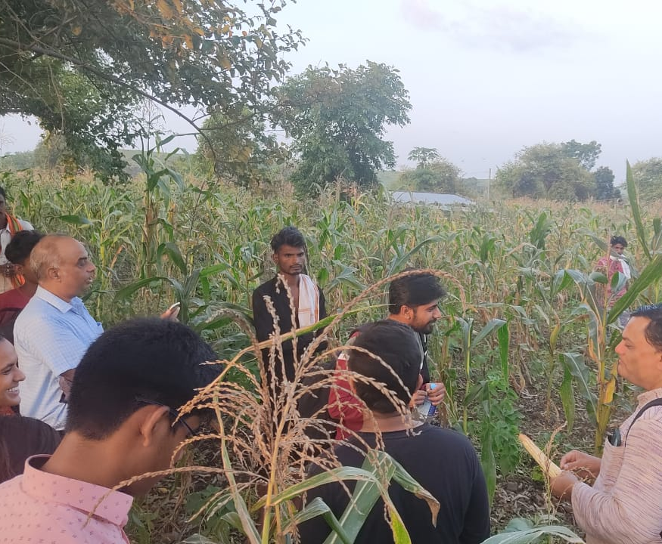
Motivation- CRDT
Field visit by one of our team members- TEJAS in the CRDT Department to a tribal village, also served as motivation for this project.

Slide 5
APPLICATIONS
It can be used to maintain the required moisture content in soil with less human intervention.
It can detect and mitigate the water logging which frequently occurs in fields .
It can be used by farmers to achieve better crop yield in their respective fields.
The system has the flexibility to take the desired input as threshold value from the user.

Slide 6
Future Scope
The system can be integrated with NPK sensors to detect other parameters than moisture content,
An application can be made to take the input of threshold from the user remotely by their respective mobile devices through wifi.
Can also be used to on/off the pumps supplying water apart from drip irrigation valves.
A timer of few minutes (say 10 mins) can be set before discharging water in waterlogging conditions to prevent false cases.

Slide 7
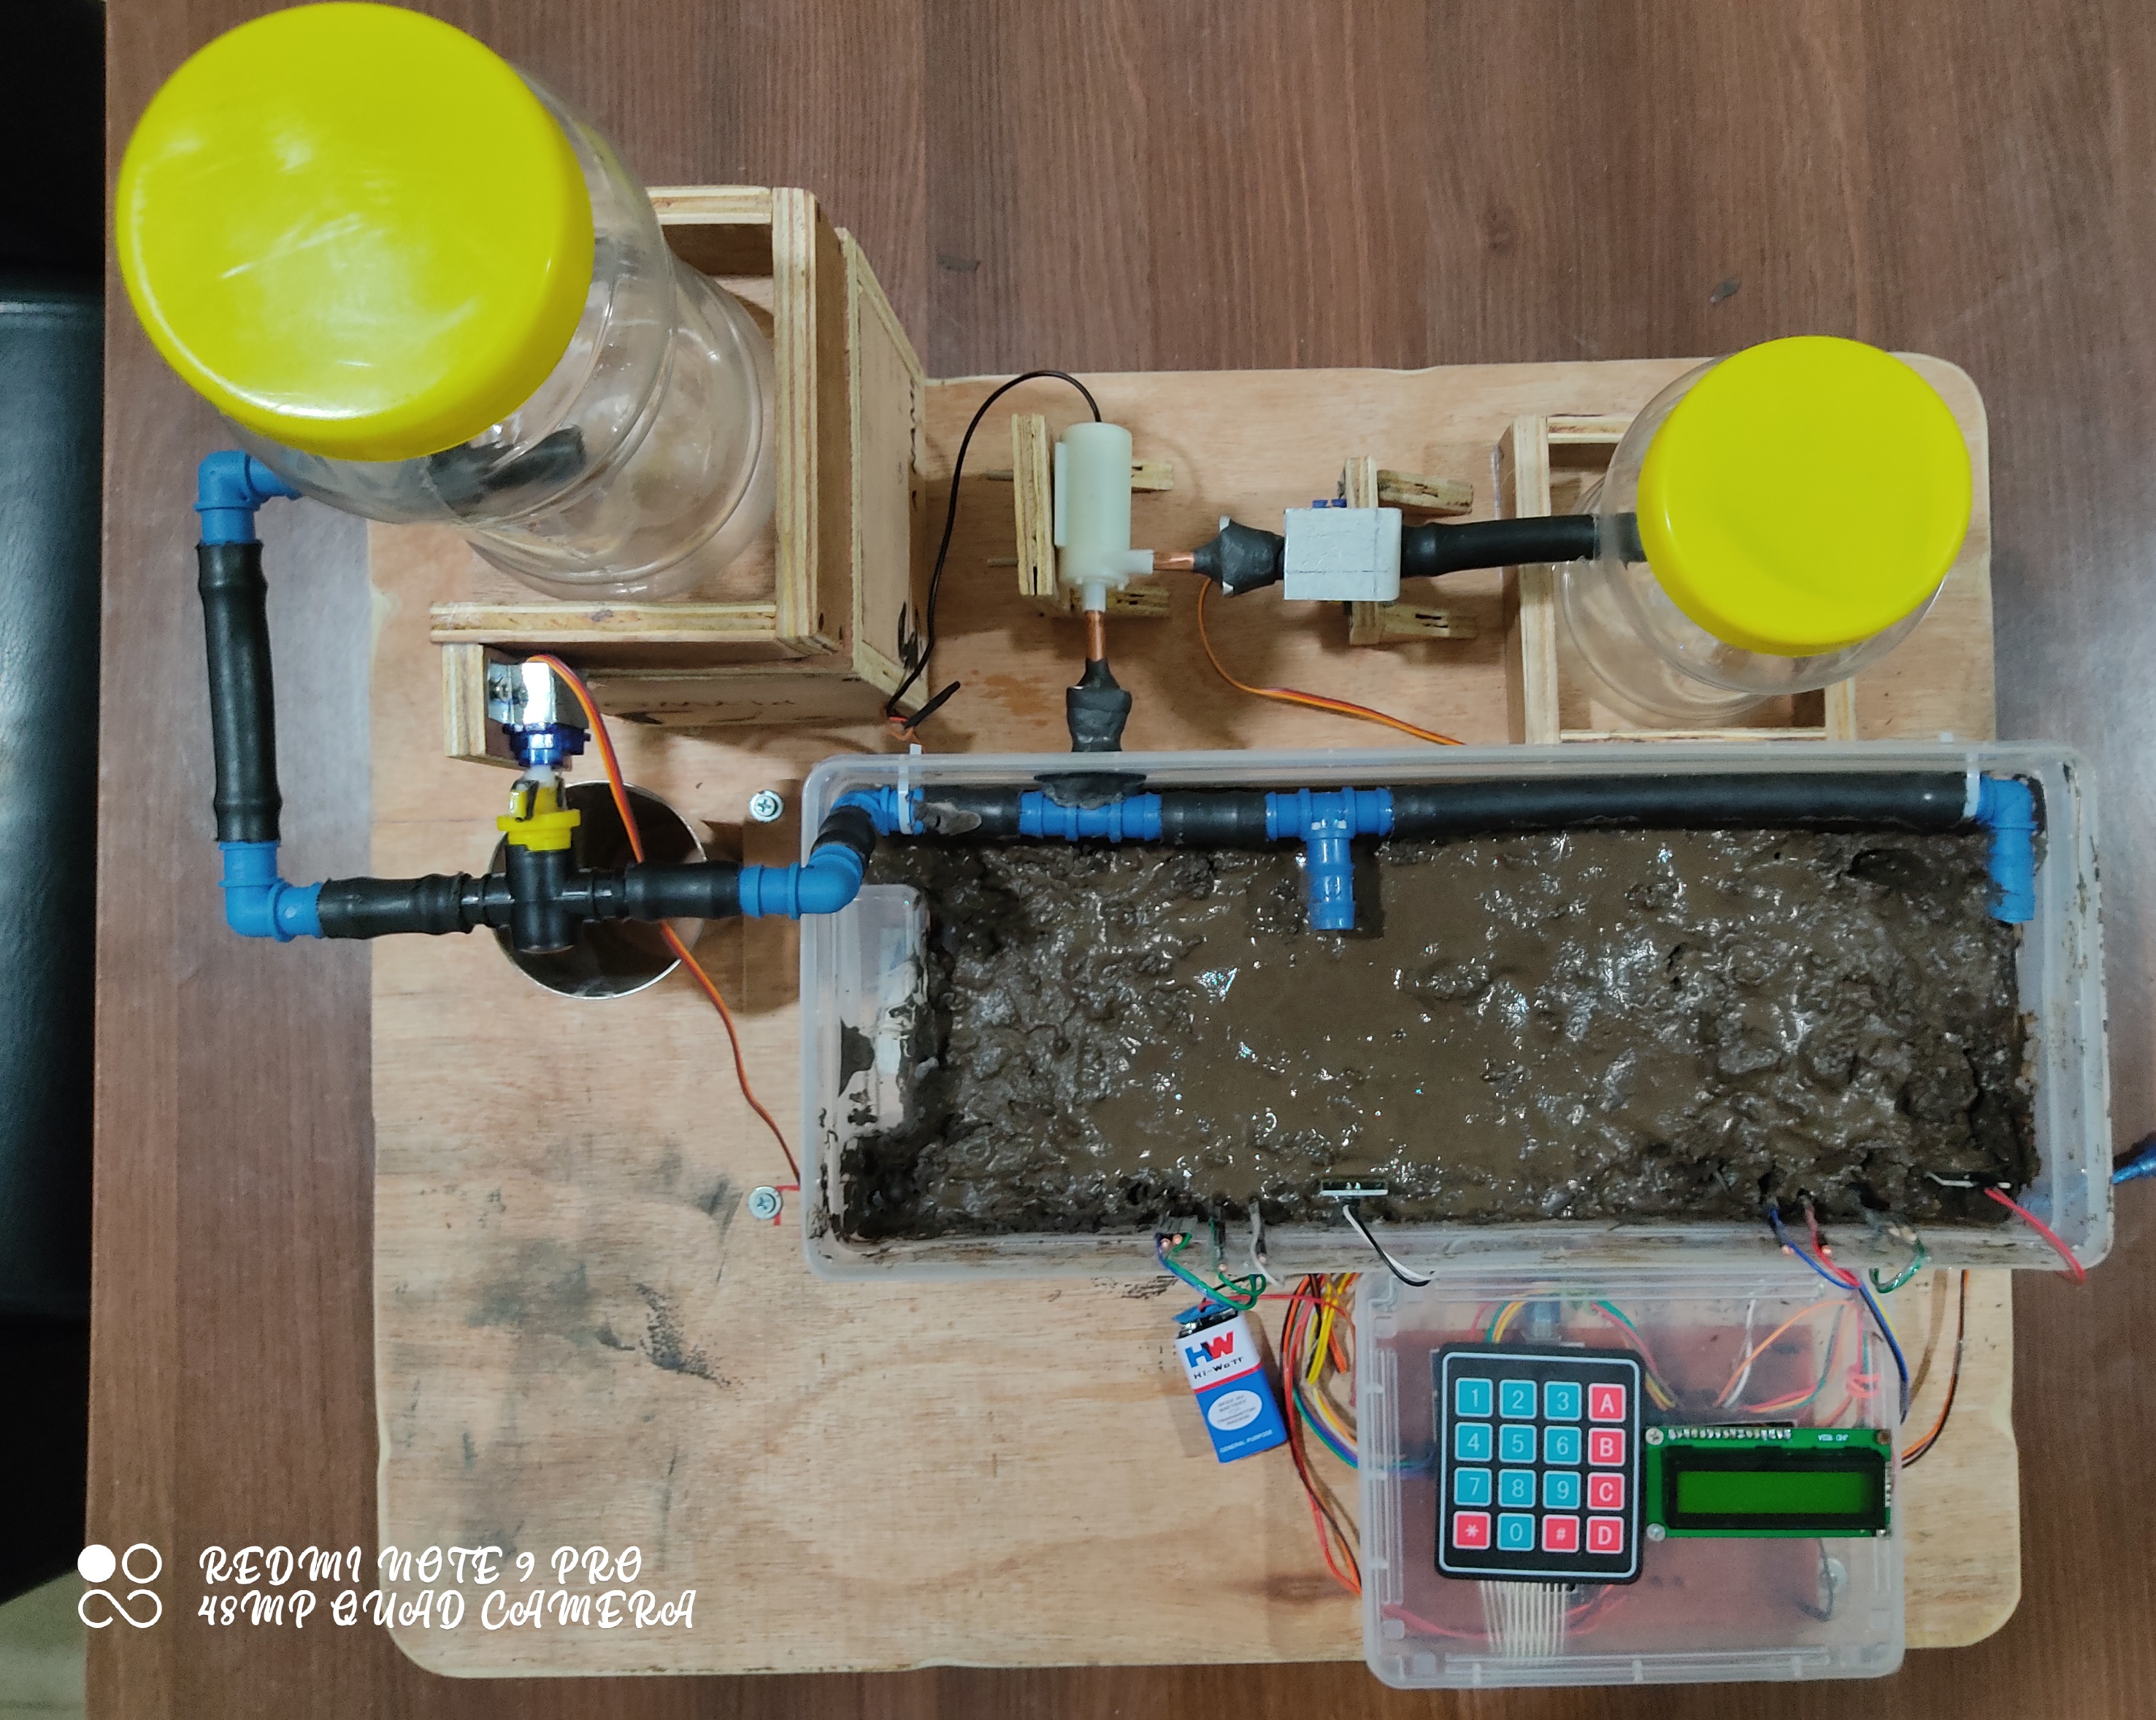
Our demo model
DischargePump
Supply Tank
Discharge Valve(V2)
Discharge Tank
Supply Valve (V1)
Irrigation System
Keypad
LCD Display and Circuit

Slide 8
Arduino code fLOW
Read the data from both the moisture sensors
Take input of threshold value from the user
Check whether the water logging condition is present
If Yes
If No
Close the supply valve and open the discharge valve and start the pump
Close the pump and discharge valve.
Open the supply valve depending upon the readings from moisture sensor

Slide 9

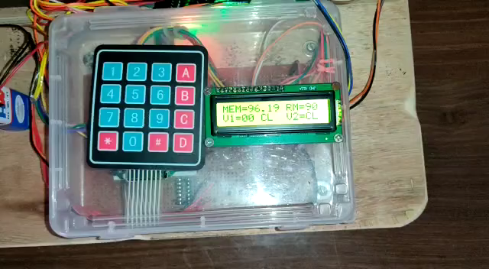
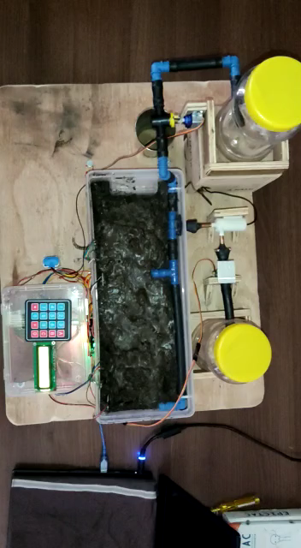
Video Demonstration

